Slide 1
The Historical Thesaurus
May 2025

Slide 2
historical thesaurus of english
ht.ac.uk
www.glasgow.ac.uk/thesaurus

Slide 3
[…] the primacy of meaning, and the analysis of meaning, as the essential tool and criterion for the study of any language [and] nothing less than classification, by meaning, of the whole if one is to begin to understand the parts.
Alexander and Kay (2023)
‘Why a Historical Thesaurus’
https://ht.ac.uk/why/

Slide 4
Put at its simplest, its purpose is to provide a detailed record of the English vocabulary from the earliest times to the present, with sufficient accompanying information that, for any given period in the past, the user should be able to ascertain the exact state of the vocabulary (i.e. the ‘lexical system’) which existed at that time.
Alexander and Kay (2023)
‘Why a Historical Thesaurus’
https://ht.ac.uk/why/

Slide 9
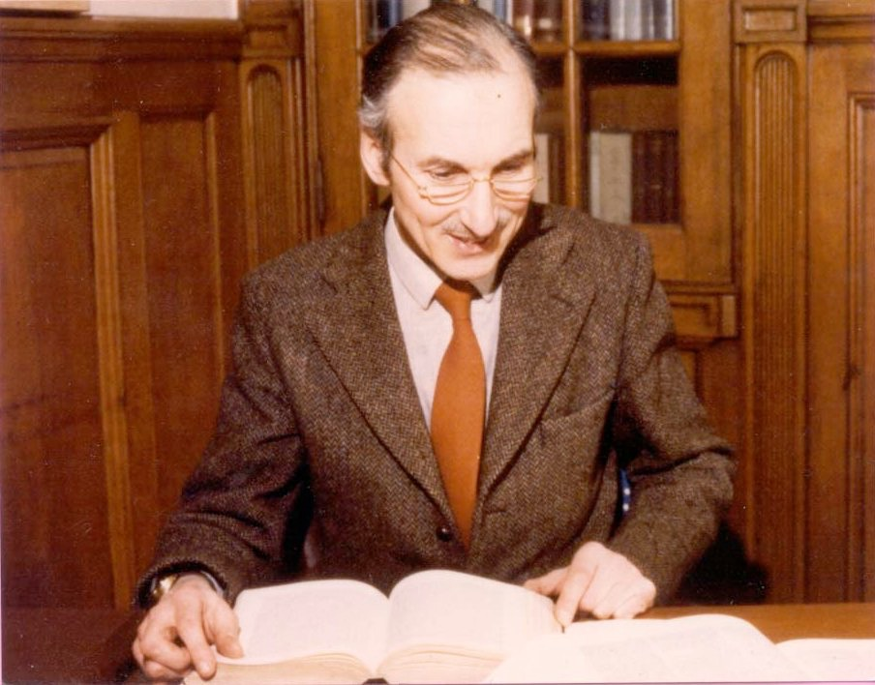
Michael Samuels
Notes:
1920-2010
15 January 1965
Retired 1989

Slide 10
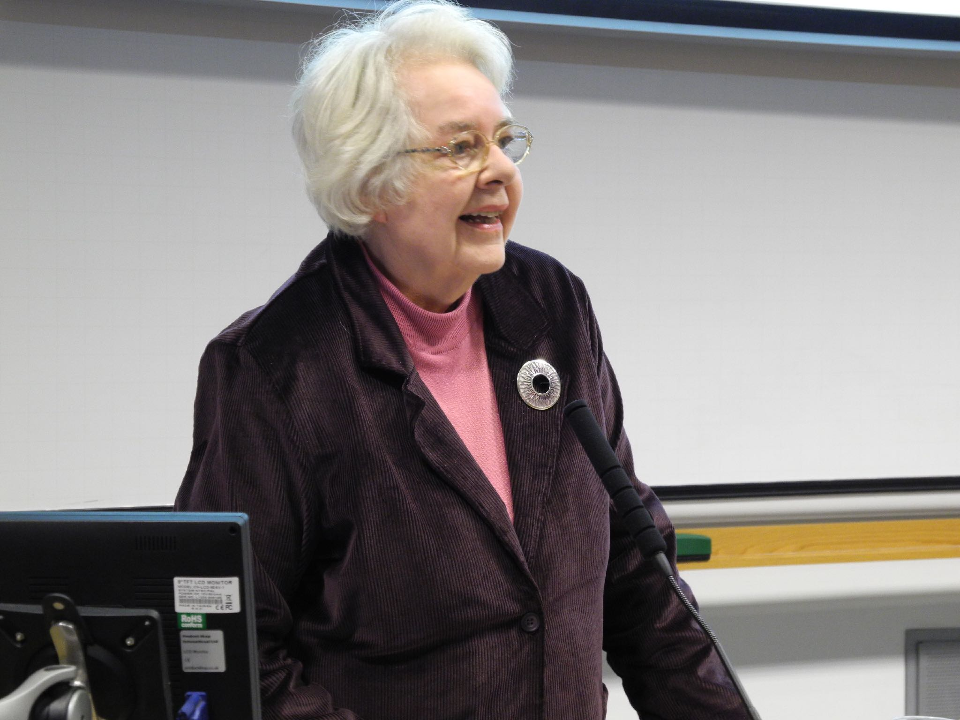
Christian J. Kay
Notes:
1940-2016
Retired 2005

Slide 11
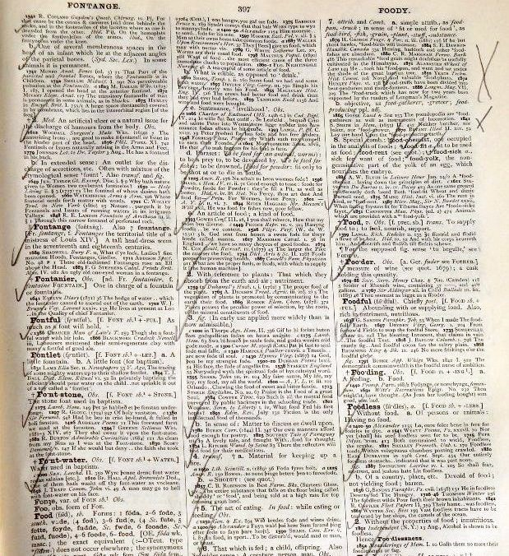

Slide 12
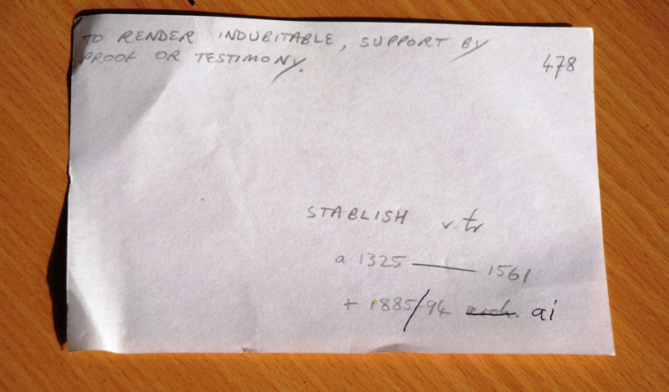

Slide 13
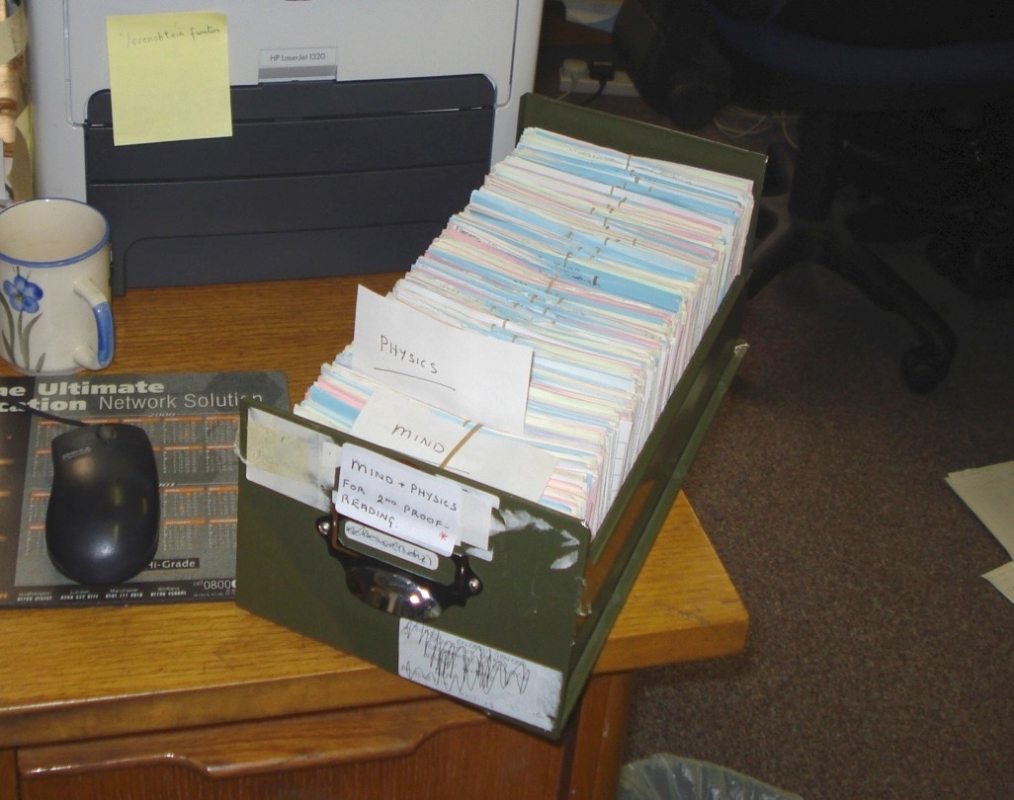

Slide 14
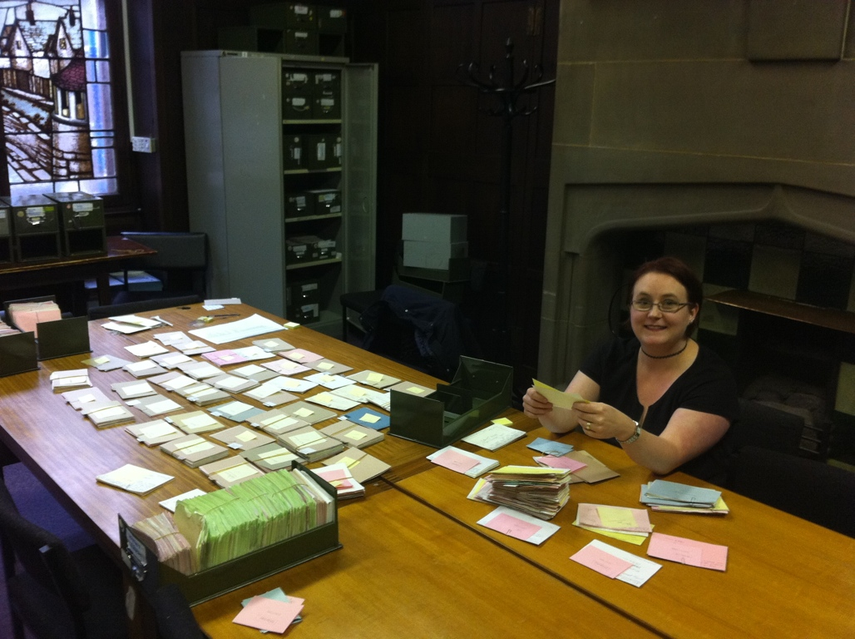

Slide 15
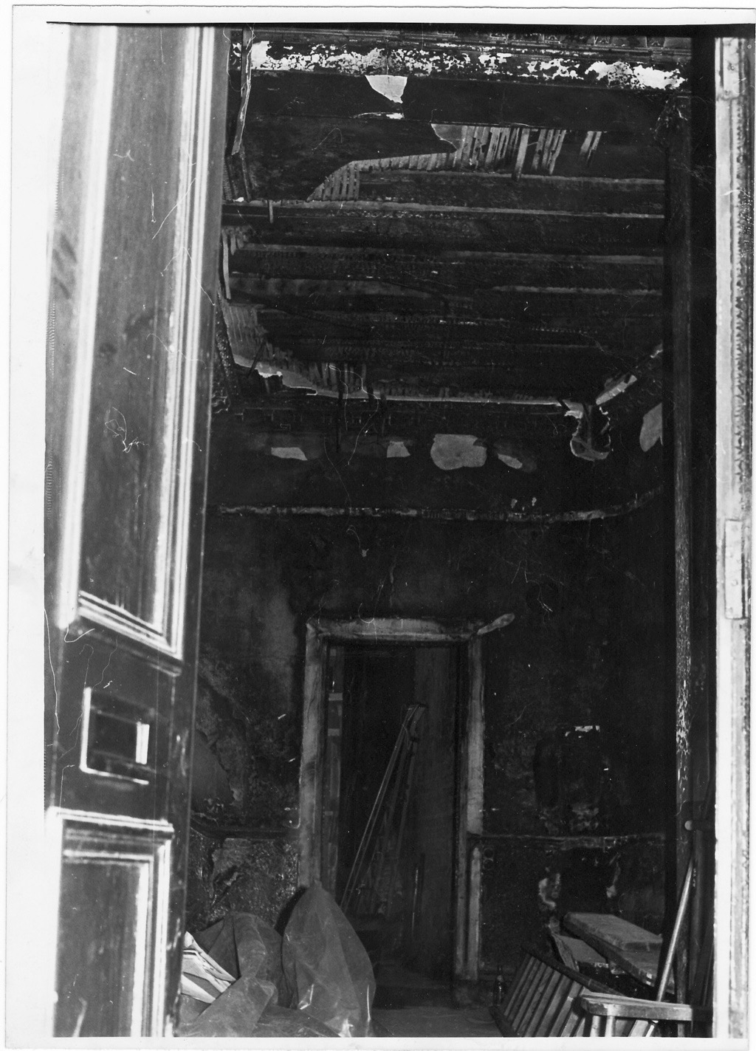
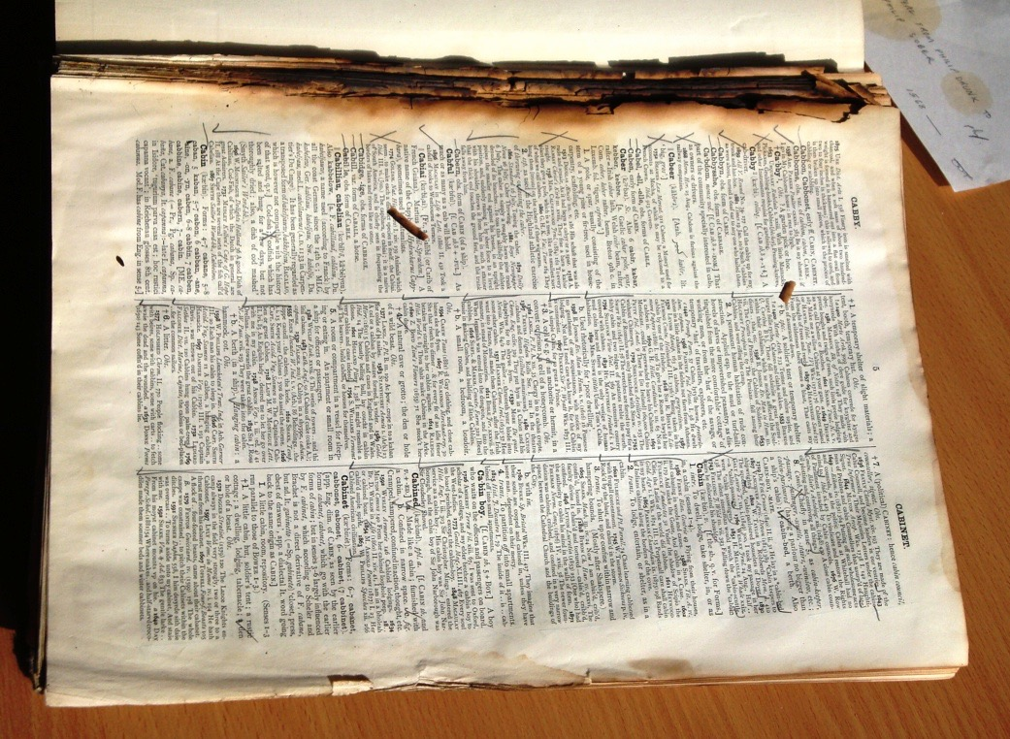

Slide 16
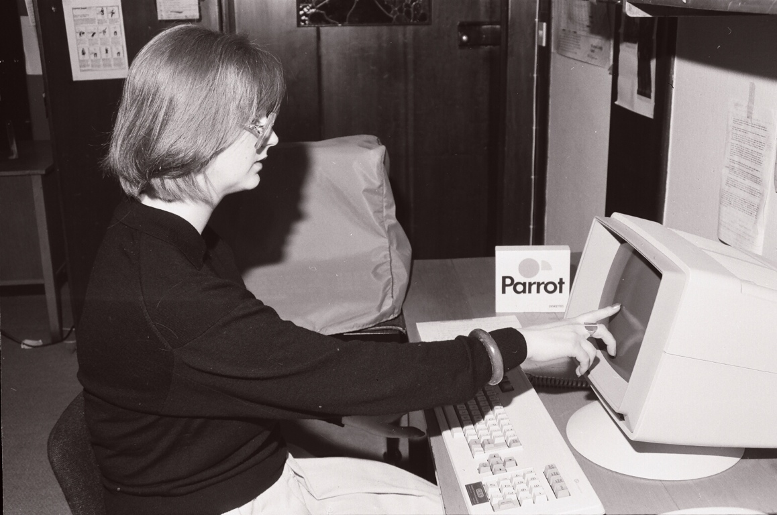

Slide 17
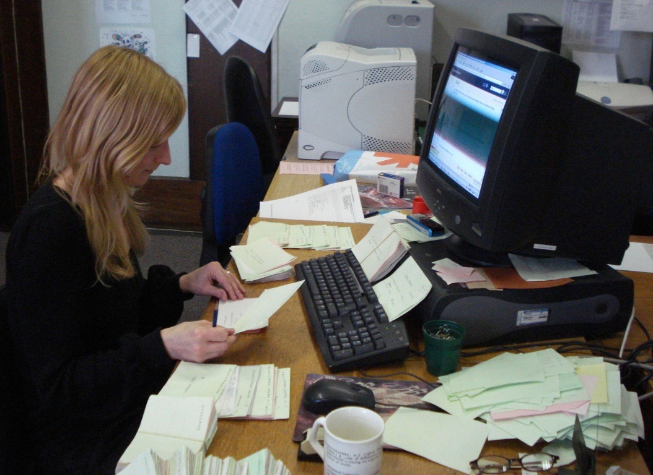

Slide 18
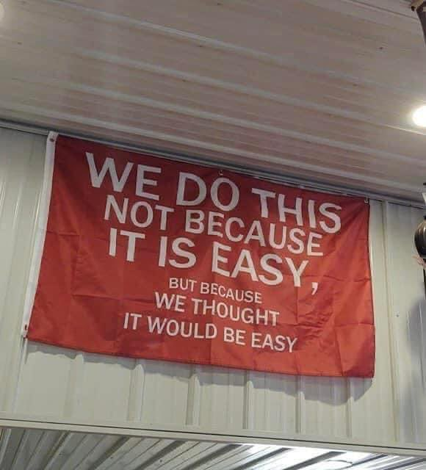

Slide 19
804,830
Entries
(Words)
3.4
Words for each concept (on average)
235,249
Categories
(Concepts)

Slide 20
Patchworks

Slide 21
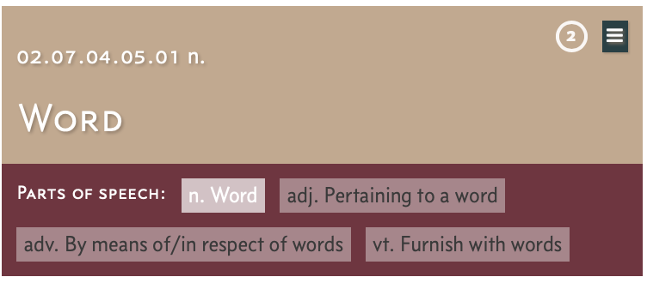
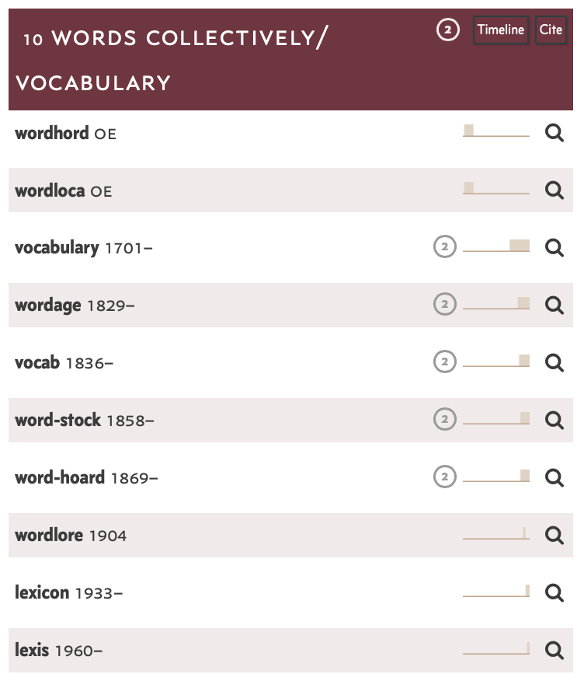
ht.ac.uk

Slide 22
wordhord oe | wordloca oe | vocabulary 1701– | wordage 1829– | vocab 1836–
word-stock 1858– | word-hoard 1869– | wordlore 1904 | lexicon 1933– | lexis 1960–

Slide 23
wordhord oe | wordloca oe | vocabulary 1701– | wordage 1829– | vocab 1836–
word-stock 1858– | word-hoard 1869– | wordlore 1904 | lexicon 1933– | lexis 1960–

Slide 24
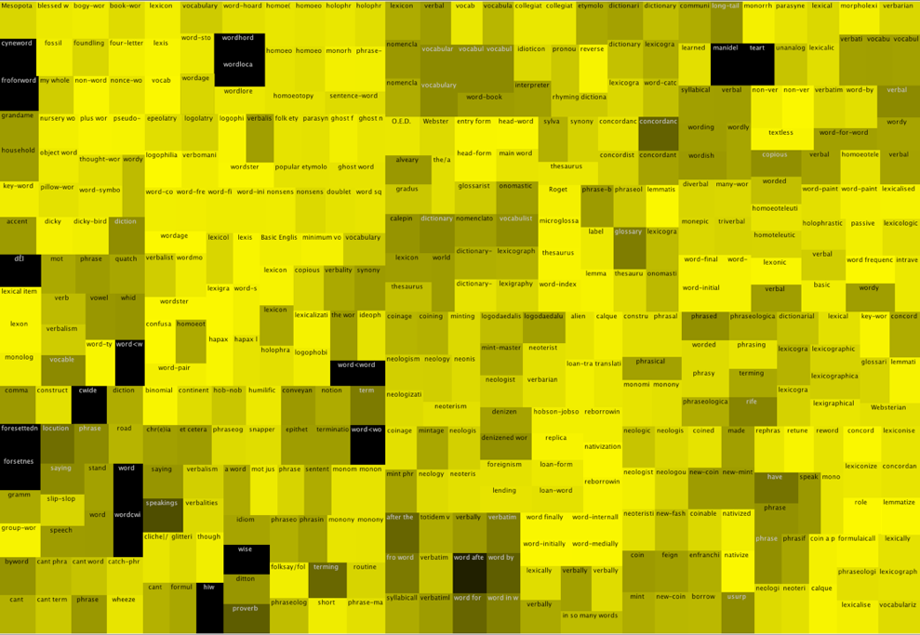
02.08.04.05 Words and Phrases
430 words

Slide 25
02.08.04.05 Words and Phrases
430 words

Slide 26
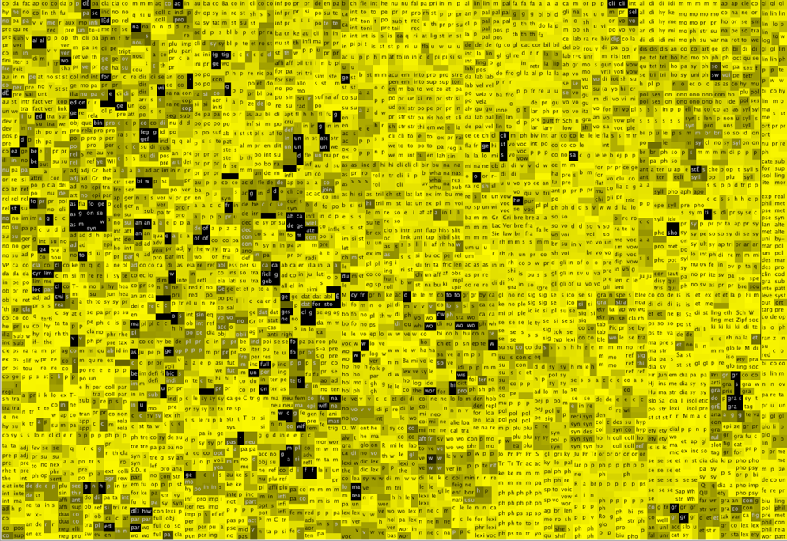
02.08.04 Study of Language
4,652 words

Slide 27
02.08.04 Study of Language
4,652 words

Slide 28
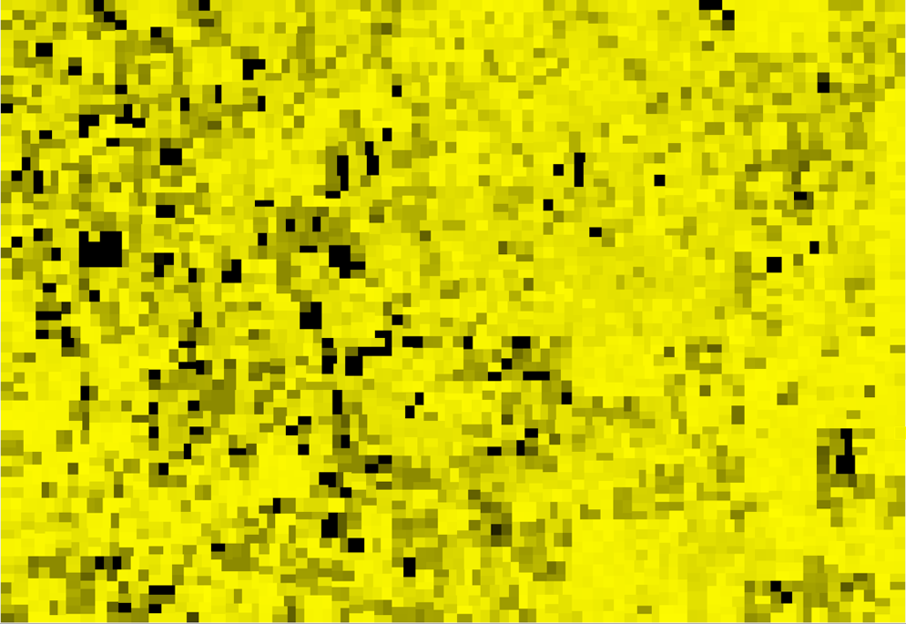
02.08.04 Study of Language
4,652 words

Slide 29
02.08 Language
18,582 words

Slide 30
02.08 Language
18,582 words

Slide 31
Modern English
469,470 words;
those cited after 1860ce
or marked as ‘current’

Slide 32
Food and Drink
Health and Disease
The Body
Biology
Leisure
Work
People
Clothing
Animals
Plants
Authority
Communication
Armed Hostility
Textiles
Cleanliness
Death
(Other)
Society
Dwelling
Action
Physics
Chemistry
Number
Travel
Faith
Wholeness
Quantity
Morality
Education
Colour
Constitution of Matter
Space
Movement
Relative Properties
Mental
Capacity
Emotion
Possession
Properties of Materials
The Earth
Physical
Sensibility
Faculty of Will
Language
Time
Existence, Creation, Causation
Aesthetics
Philosophy
The Supernatural
Refusal and Denial
Modern English
469,470 words;
those cited after 1860ce
or marked as ‘current’

Slide 33
Modern English
469,470 words;
those cited after 1860ce
or marked as ‘current’

Slide 34
The Age of Johnson
247,933 words;
those first cited before 1784ce, and last cited after 1709ce

Slide 35
The Age of Shakespeare
207,930 words;
those first cited before 1616ce, and last cited after 1564ce

Slide 36
The Age of Chaucer
73,432 words;
those first cited before 1400ce, and last cited after 1340ce

Slide 37
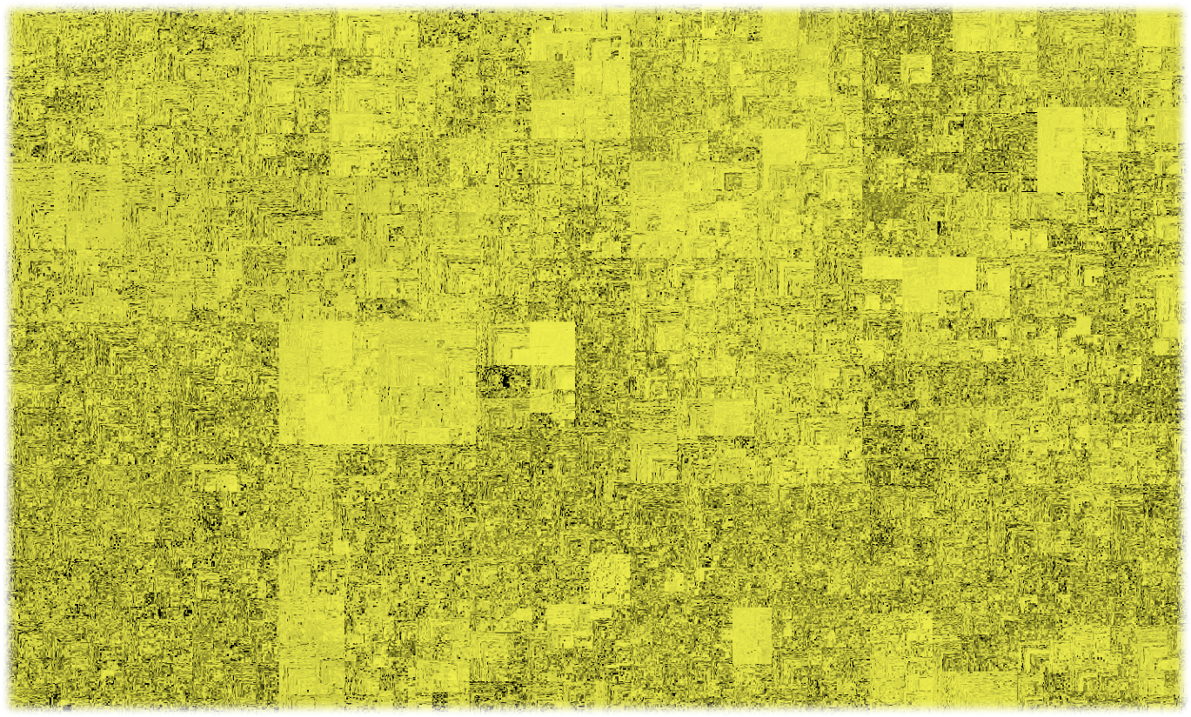

Slide 39
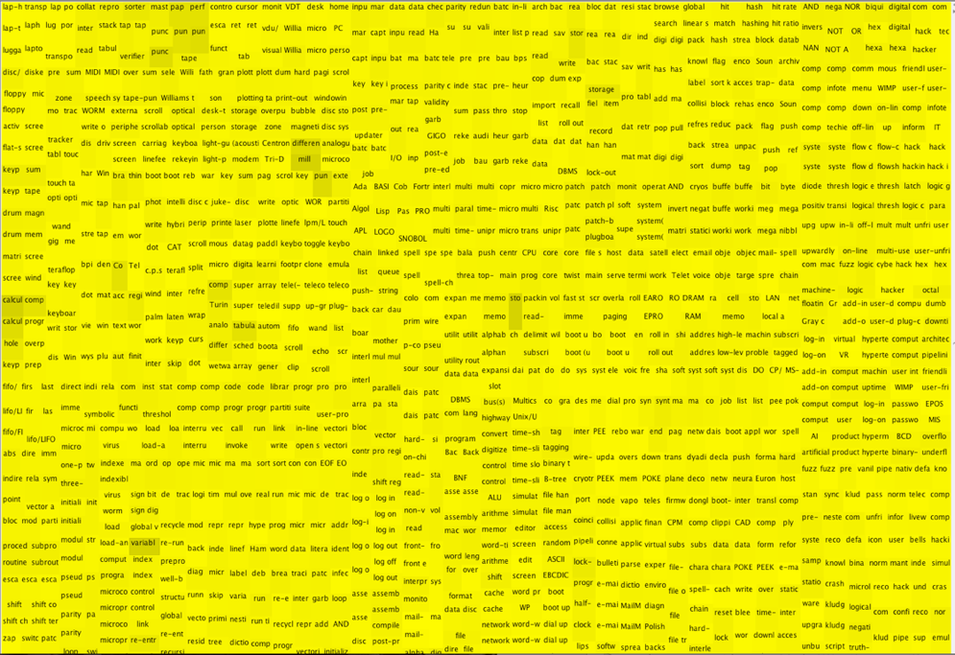
01.06.04.15 Computing, n.
1320 words

Slide 40
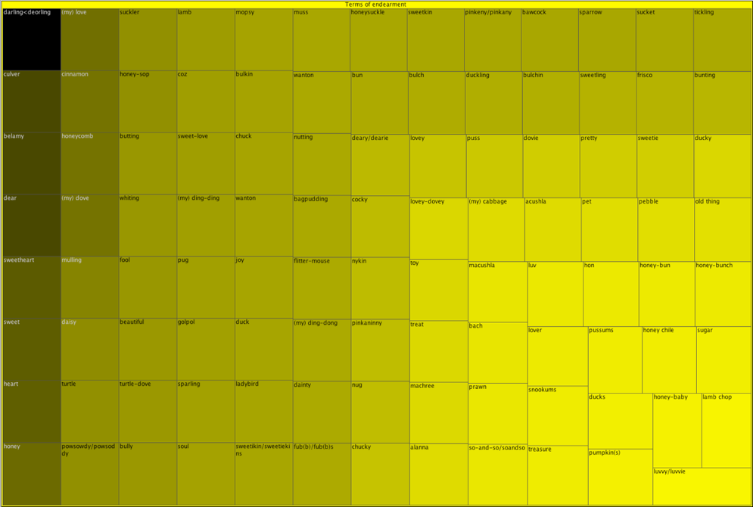
02.04.13|04 Terms of endearment, n.

Slide 42
Sensitivity

Slide 43
Society > Morality > Moral evil > Licentiousness > Unchastity > Prostitution (Modern attitudes are not that prostitution is a form of moral evil)
Lapse of chastity, now sexual misadventure
Begetting or bearing bastards, now producing illegitimate children
Defile by adultery, now commit adultery with
Transsexuality previously within sexual orientation (factually incorrect; now to go within sex and gender, then raised questions on the overlapping vocabulary, like (the) closet, coming out, pride, queer, etc)
Synthetic milk now milk substitutes (contains plant milk, almond milk, soy milk, etc)
Ukraine
White person/non-white person, suggestion person of colour, but…
Vegetarian now vegetarian or vegan

Slide 44
First edition: 01.17.04.01 Christian God
Meeting suggestion: 01.17.03.02 Jewish and Christian God
OED suggestion: 01.17.04.01 God of monotheistic religions
Outcome: 01.17.03.02 God of Judaism, Christianity, and Islam

Slide 45
Uncivilized

Slide 46
The tendency of Parliament to legislate as if the people of Ireland were a set of the most incapable and helpless savages was to him a matter of regret.
Lord John Manners, Parliamentary Debates (hc), 1 April 1870 vol. 200 cc1070–1.

Slide 47
2046 references to the uncivil in Hansard from 1803–2003

Slide 48
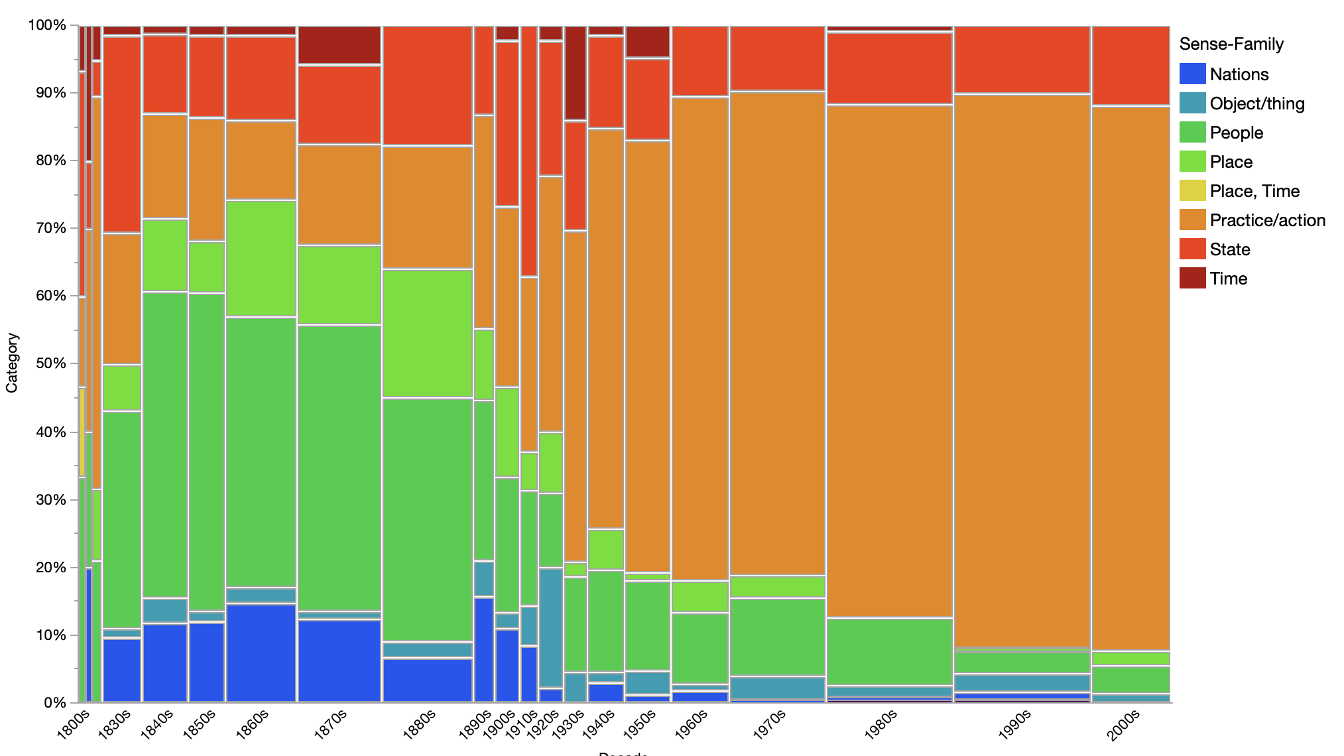

Slide 49
draconian, Hansard

Slide 50
Lexical Words

Slide 51
Hansard Commons

Slide 52
Hansard Commons

Slide 53
Hansard Commons

Slide 54
SEEBO

Slide 55
Hansard Commons
SEEBO

Slide 56
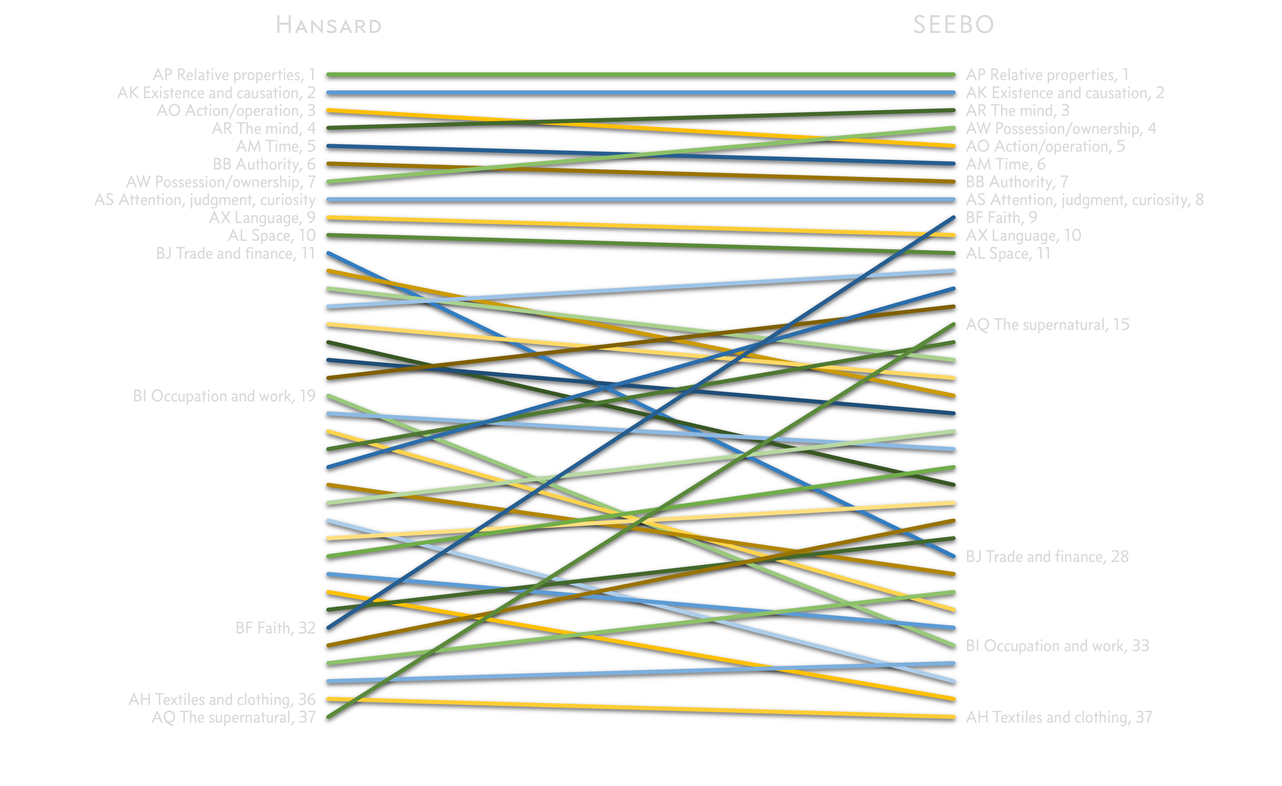

Slide 58
Type 0
Grammatical Words
Type I
?
Type II
Lexical Words

Slide 59
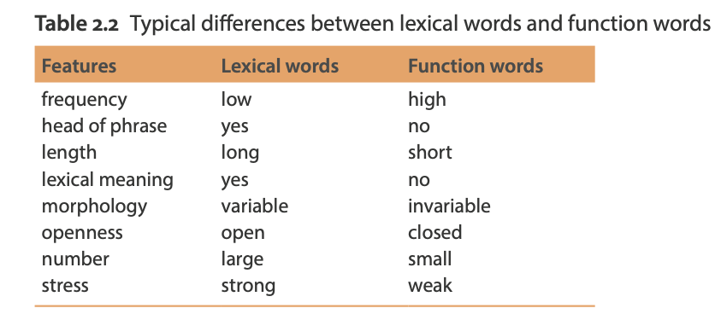
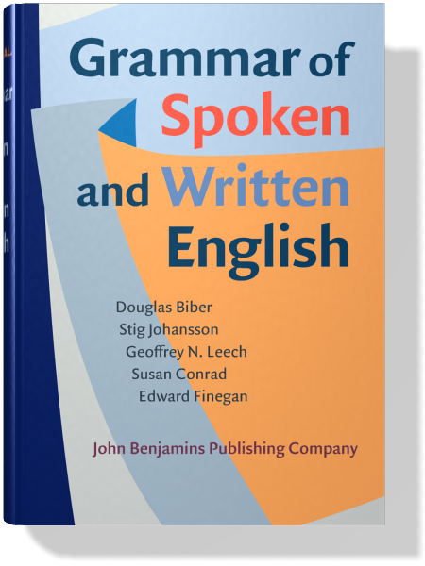
Biber, Douglas, Stig Johansson, Geoffrey N. Leech, Susan Conrad, Edward Finegan. 2021. Grammar of Spoken and Written English. Amsterdam: John Benjamins. p.57

Slide 60
AP Relative properties
AK Existence and causation
AO Action/operation
AR The mind
AM Time
BB Authority
AW Possession/ownership (?)
AS Attention, judgment, curiosity
AX Language (?)
AL Space

Slide 61
AP Relative properties
relation: other aj, same aj av, so av, far aj av, different aj, apply v, make v, almost av
kind/sort: kind n, something av, particular aj n, any av, special n aj
order : last aj av, finally av, respect n v, suitable aj, final aj n, order n
number : one, two, three, million, first, last, per cent n av, few
measurement : measure n v, mile n, acre n, tonne n, gallon n, tonnage n, acreage n
quantity : very av aj, some av, also av, most av, much av, too av, increase v n, further av aj
wholeness : all av, part n av, whole aj n, section n v, remainder n, fully av, include v, main aj n

Slide 62
AK Existence and causation
existence, creation, cause and effect
Examples: be, matter, way, thing, condition, state, produce, because, reason, happen, place, now, event, occur, proceed, circumstance

Slide 63
AO Action/operation
doing, undertaking, beginning, repeating, continuing, carrying out, completing, ceasing, inaction, endeavour, difficulty, easiness, amending, advantage, safety, prosperity, harm, adversity, failure, manner of action, ability
Examples: involve, do, liable, business, undertake, commit, beginning, repeat, continue, implement, complete, achieve, cease, stop, adjourn, keep, find, seek, attempt, opposition, favour, reform, amend, remedy, help, aid, opportunity, protection, achieve, progress, success, danger, treat, risk, unfortunate, hardship, disastrous, fail, defeat, detail, carefully, able, enable, ability, skill

Slide 64
AR The mind
Mind, intellect, consciousness, character, mood, psychology, thinking, perception, intuition, ideas, imagination, idealism, creativity, understanding, intelligence, wisdom, reason, sophistry, irrationality, stupidity, absurdity, stupid, explanation, ambiguity, obscurity, misinterpretation, memory, knowledge, ignorance, truth, exaggeration, falsehood, deceit, secrecy, belief, opinion, uncertainty, confidence, expectation, foresight
AM Time
Time, duration, year, month, week, today, early, hour, June, July, day, afternoon, tonight, morning, clock, bell, schedule, o’clock, timetable, era, calendar, frequency, now, then, before, soon, delay, postpone, again, always, never, once, sometimes, maintain, establish

Slide 65
AP Relative properties
AK Existence and causation
AO Action/operation
AR The mind
AM Time
BB Authority
AW Possession/ownership (?)
AS Attention, judgment, curiosity
AX Language (?)
AL Space

Slide 66
Biber, Douglas, Stig Johansson, Geoffrey N. Leech, Susan Conrad, Edward Finegan. 2021. Grammar of Spoken and Written English. Amsterdam: John Benjamins. p.57
Frequency: high
Head of phrase: yes
Length: long(?)
Lexical meaning: ?
Morphology: variable
Openness: open
Number: ?

Slide 67
Type 0
Grammatical Words
Type I
?
Type II
Lexical Words

Slide 68
Biber, Douglas, Stig Johansson, Geoffrey N. Leech, Susan Conrad, Edward Finegan. 2021. Grammar of Spoken and Written English. Amsterdam: John Benjamins. p.57
Frequency: high
Head of phrase: yes
Length: long(?)
Lexical meaning: lexical-ish
Morphology: variable
Openness: open
Number: large-ish

Slide 69
Type 0
Grammatical Words
Type I
’Semantic Scaffolds’
Type II
Lexical Words

Slide 70
Thank you!
ht.ac.uk
www.english-corpora.org/hansard

